Slide 1
Good morning class!!!

Slide 2
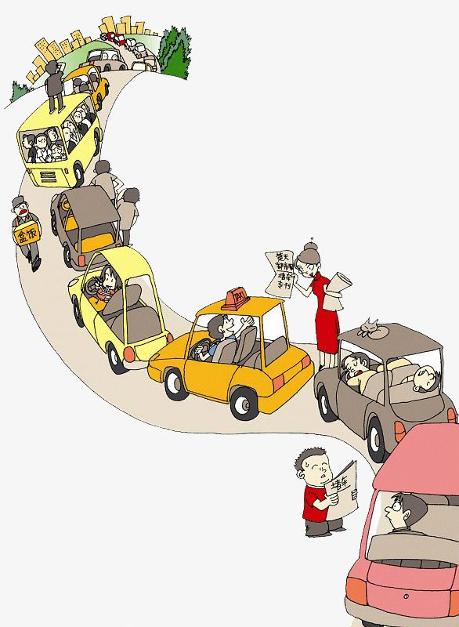
* WARM-UP
BRAIN STORMING:
- Cross the red light
Traffic problems
- Drink alcohol, beer
- Not obeying traffic laws
- traffic jam
- too many vehicles
- drive line up when riding on the road
- driving too fast, overtaking carelessly
- Cross the red light:
- many narrow roads

Slide 3
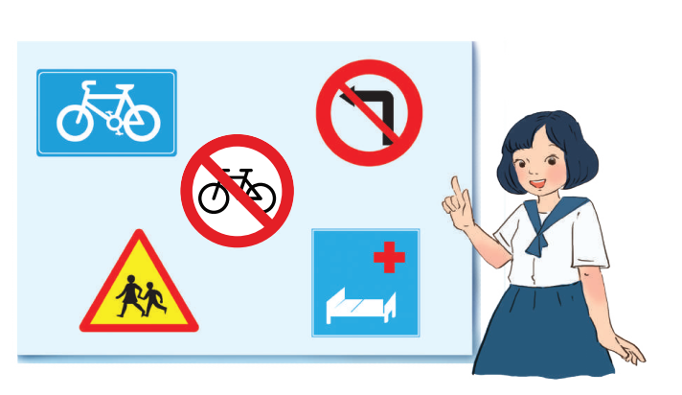
7
7
TRAFFIC
Unit
TRAFFIC
Unit
LESSON 5: SKILLS 2

Slide 4
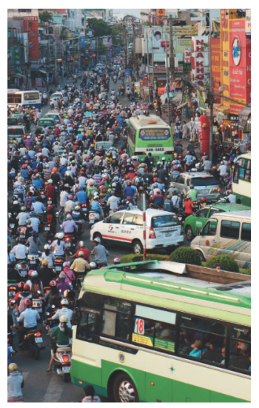
I. LISTENING
1
Discuss: What can you see in this picture? What is special about it?
- I can see a lot of vehicles on the road.
- I can see a traffic jam.
- I can see that some drivers don't obey traffic laws/rules.
I can see that it's very dangerous.
→ It’s a serious traffic jam.

Slide 5
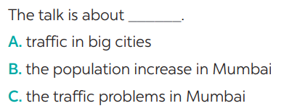
2
Listen to the recording and choose the correct answer A, B, or C

Slide 6
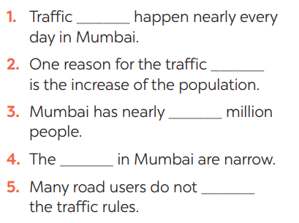
3
Listen again and write ONE word or number in each gap
problems
jams
20/twenty
roads
obey

Slide 7
*Tape transcript
Big cities around the world have traffic problems. Mumbai in India is one of them. Mumbai is one of the most congested cities in the world. Traffic jams happen nearly every day, so drivers have to spend a lot of time on the road.
There are several reasons for traffic jams in this city. One reason is its increase in population. With nearly 20 million, Mumbai has too many people on the road. Another reason is that the roads in Mumbai are narrow, and many are not in good condition. Also, many road users do not obey the traffic rules. As a result, this problem is getting worse and worse.

Slide 8
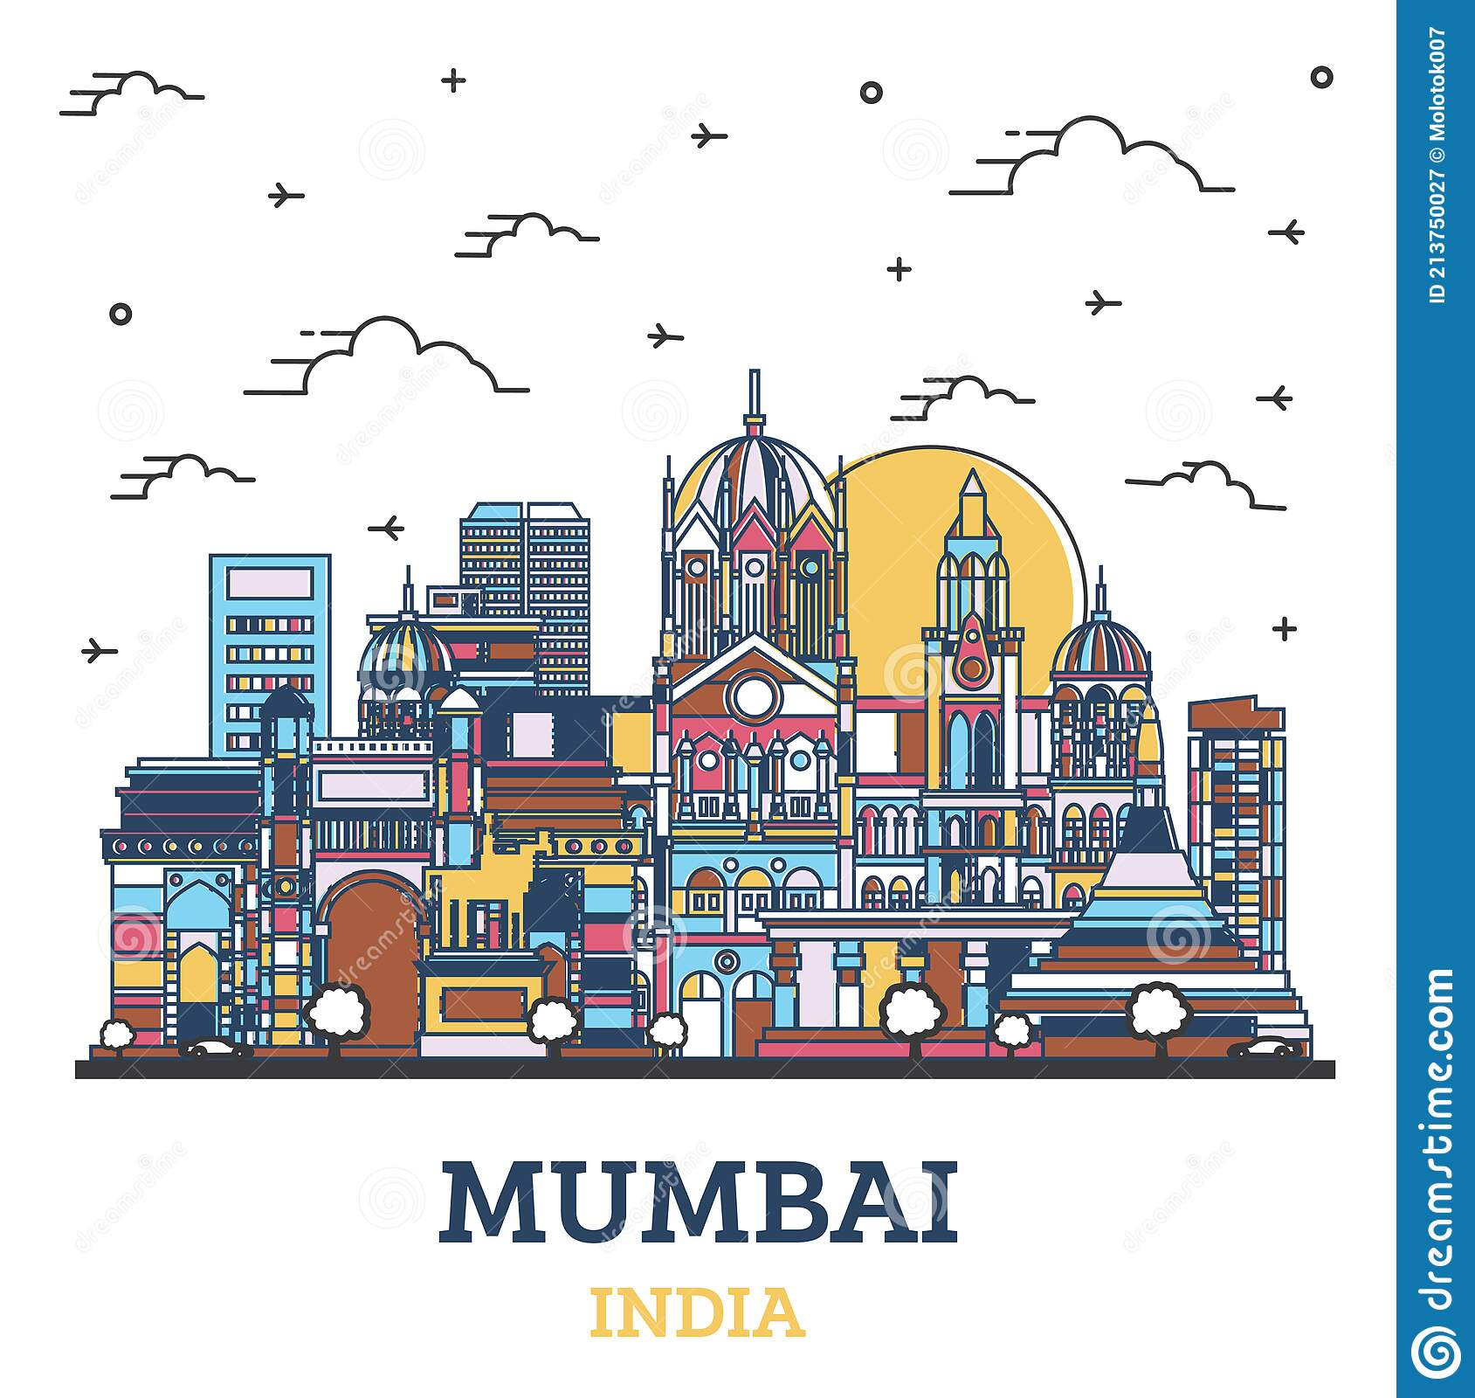
4
Discuss: Compare traffic problems in Mumbai to the traffic problems in Hanoi.
The traffic jams in Hanoi are as serious and frequent as they are in Mumbai.

Slide 9
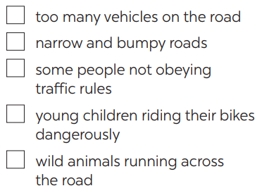
II. WRITING
5
Tick the traffic problems in big cities in Viet Nam.





Slide 10
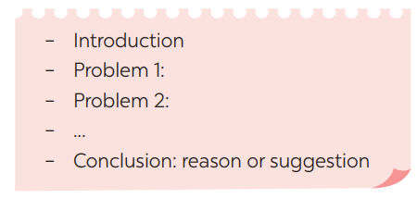
6
Write a paragraph of about 70 words about the traffic problems in your town / city.

Slide 11
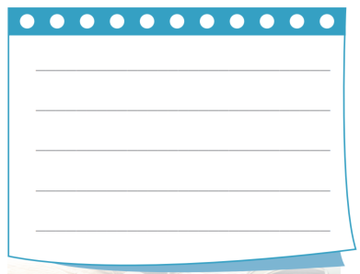
6
Write a paragraph of about 70 words about the traffic problems in your town / city.
I live in Quang Ngai city. It is a small and busy city. There are lots of vehicles on the road all day. There are lots of cars, buses, taxis and trucks on high ways. Most people travel by motorbike. Every family has a motorbike. The traffic jam is often at about 7 a.m and 5 p.m because it’s the time when people go to work or school and come back home. There are sometimes accidents on the road. Therefore, to reduce these problems, we need to obey traffic rules to reduce accidents as much as possible.

Slide 12
* POST - WRITING
* Peer check and cross check
Students can:
go and see other’s work
give comments to each other

Slide 13
CONSOLIDATION
In this lesson, we have learnt to:
Some words related to the topic Traffic
listen for main ideas and specific information about traffic problems in Mumbai.
write about traffic problems in your area.

Slide 14
* homework
Learn new words by heart.
Redo all the exercises.
Prepare: Looking back & Project

Slide 15
Goodbye!
See you again
Thank you!
Have a nice day!

